Slide 1
Experiment & Exam
Week | Experiment | Room
7 | Experiment 1: Programming with MS Visual Studio | 10-414
12 | Experiment 2: Branch and loop programming | 10-413
15 | Experiment 3: Procedure programming
16 | Final Exam | 10-414
Please bring your own laptop (with x86 CPU) if possible.
Irvine, Kip R. Assembly Language for Intel-Based Computers 5/e, 2007.

Slide 2
Chapter 7: Homework
Common Problems:
Do not use ret instruction in main procedure, use exit at the end of the main procedure to make sure your program exit properly
Use registers to pass parameters to a procedure, do not use variables to pass parameters
Write comment for a procedure if the parameters are passed by registers, indicate the correspondence of each parameter to the specific register
Irvine, Kip R. Assembly Language for Intel-Based Computers 5/e, 2007.

Slide 3
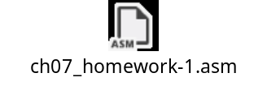
Chapter 7: Homework
1. The time stamp of a MS-DOS file directory entry uses bits 0 through 4 for the number of 2-second increments, bits 5 through 10 for the minutes, and bits 11 through 15 for the hours (24-hour clock). For example, the following binary value indicates a time of 02:16:14, in hh:mm:ss format:
00010 010000 00111
Write a procedure named ShowFileTime that receives a binary file time value in the AX register and displays the time in hh:mm:ss format. Test the procedure in a simple program. Submit your code and the screenshot of the input/output of your test program in the consoler.
Irvine, Kip R. Assembly Language for Intel-Based Computers 5/e, 2007.

Slide 4
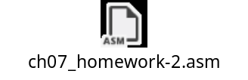
Chapter 7: Homework
2. The greatest common divisor (GCD) of two integers is the largest integer that will evenly divide both integers. The GCD algorithm involves integer division in a loop, described by the following C++ code:
int GCD(int x, int y) {
x = abs(x); // absolute value
y = abs(y);
do {
int n = x % y;
x = y;
y = n;
} while (y > 0);
return x;
}
Implement this function as a procedure in assembly language and write a test program that calls the procedure several times, passing it different values. Display all results on the screen. Submit your code and the screenshot of the input/output of your test program in the consoler.
Irvine, Kip R. Assembly Language for Intel-Based Computers 5/e, 2007.

Slide 5
Assembly Language for Intel-Based Computers, 6th Edition
Kip R. Irvine
Chapter 8: Advanced Procedures
Slides prepared by Kip R. Irvine
Revision date: June 4, 2006
(c) Pearson Education, 2006-2007. All rights reserved. You may modify and copy this slide show for your personal use, or for use in the classroom, as long as this copyright statement, the author's name, and the title are not changed.

Slide 6
Chapter Overview
Stack Frames
Recursion
INVOKE, ADDR, PROC, and PROTO
Irvine, Kip R. Assembly Language for Intel-Based Computers 5/e, 2007.

Slide 7
Stack Frames
Stack Parameters
Local Variables
ENTER and LEAVE Instructions
LOCAL Directive
WriteStackFrame Procedure
Irvine, Kip R. Assembly Language for Intel-Based Computers 5/e, 2007.

Slide 8
Stack Frame
A stack frame (or activation record) is the area of the stack set aside for passed arguments, subroutine return address, local variables, and saved registers.
The stack frame is created by the following sequential steps:
  Passed arguments, if any, are pushed on the stack.
  The subroutine is called, causing the subroutine return address to be pushed on the stack.
  As the subroutine begins to execute, EBP is pushed on the stack.
  EBP is set equal to ESP. From this point on, EBP acts as a base reference for all of the subroutine parameters.
  If there are local variables, ESP is decremented to reserve space for the variables on the stack.
  If any registers need to be saved, they are pushed on the stack.
Irvine, Kip R. Assembly Language for Intel-Based Computers 5/e, 2007.

Slide 9
Stack Parameters
Do not need to manage registers, more convenient than register parameters
Can support more parameters
Maybe slower than fast call
Fast call:
pushad
mov esi,OFFSET array
mov ecx,LENGTHOF array
mov ebx,TYPE array
call DumpMem
popad
push TYPE array
push LENGTHOF array
push OFFSET array
call DumpMem
Irvine, Kip R. Assembly Language for Intel-Based Computers 5/e, 2007.

Slide 10
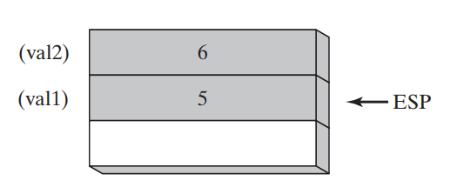
Passing Parameters by Value
.data
val1 DWORD 5
val2 DWORD 6
.code
main PROC
push val2 ; second argument
push val1 ; first argument
call AddTwo ; EAX = sum
mov sum,eax ; save the sum
. . .
main ENDP
AddTwo PROC
push ebp
mov ebp,esp
.
.
Irvine, Kip R. Assembly Language for Intel-Based Computers 5/e, 2007.

Slide 11
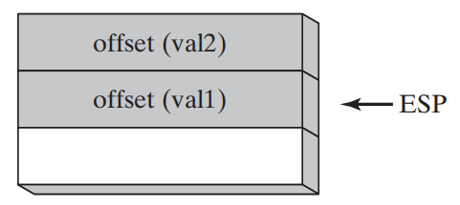
Passing Parameters by Address (Offset)
.data
val1 DWORD 1
val2 DWORD 2
.code
main PROC
push OFFSET val2 ; second argument
push OFFSET val1 ; first argument
call Swap ; Swap the values of vals
. . .
main ENDP
Swap PROC
push ebp
mov ebp,esp
.
.
Irvine, Kip R. Assembly Language for Intel-Based Computers 5/e, 2007.

Slide 12
Explicit Access to Stack Parameters
A procedure can explicitly access stack parameters using constant offsets from EBP.
  Example: [ebp + 8]
EBP is often called the base pointer or frame pointer because it holds the base address of the stack frame.
EBP does not change value during the procedure.
EBP must be restored to its original value when a procedure returns.
Irvine, Kip R. Assembly Language for Intel-Based Computers 5/e, 2007.

Slide 13
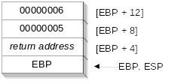
Acess Stack Parameters Using Base-Offset Addressing
.data
val1 DWORD 5
val2 DWORD 6
.code
main PROC
push val2 ; second argument
push val1 ; first argument
call AddTwo ; EAX = sum
mov sum,eax ; save the sum
. . .
main ENDP
Memory leak in stack
AddTwo PROC
push ebp
mov ebp,esp
mov eax,[ebp + 12]
add eax,[ebp + 8]
pop ebp
ret
AddTwo ENDP
Irvine, Kip R. Assembly Language for Intel-Based Computers 5/e, 2007.

Slide 14
Cleaning Up the Stack
There must be a way for parameters to be removed from the stack when a subroutine returns. Otherwise, a memory leak would result, and the stack would become corrupted.
The C Calling Convention: recover esp after call
push val2
push val1
call AddTwo
add esp,8
STDCALL Calling Convention: recover esp in subroutine
AddTwo PROC
push ebp
mov ebp,esp
mov eax,[ebp + 12]
add eax,[ebp + 8]
pop ebp
ret 8
AddTwo ENDP
Irvine, Kip R. Assembly Language for Intel-Based Computers 5/e, 2007.

Slide 15
RET Instruction
Return from subroutine
Pops stack into the instruction pointer (EIP or IP). Control transfers to the target address.
Syntax:
  RET
  RET n
Optional operand n causes n bytes to be added to the stack pointer after EIP (or IP) is assigned a value.
Irvine, Kip R. Assembly Language for Intel-Based Computers 5/e, 2007.

Slide 16
Local Variables
To explicitly create local variables, subtract their total size from ESP.
The following example creates and initializes two 32-bit local variables (we'll call them locA and locB):
MySub PROC
push ebp
mov ebp,esp
sub esp,8
mov [ebp-4],123456h ; locA
mov [ebp-8],0 ; locB
.
.
Irvine, Kip R. Assembly Language for Intel-Based Computers 5/e, 2007.

Slide 17
LEA Instruction
The LEA instruction returns offsets of both direct and indirect operands.
  OFFSET operator can only return constant offsets.
LEA is required when obtaining the offset of a stack parameter or local variable. For example:
MakeString PROC
push ebp
mov ebp,esp
sub esp,32
mov edi,OFFSET [ebp-30] ; invalid operand
lea edi,[ebp-30] ; ok
Irvine, Kip R. Assembly Language for Intel-Based Computers 5/e, 2007.

Slide 18
ENTER and LEAVE
ENTER instruction creates stack frame for a called procedure
  pushes EBP on the stack
  sets EBP to the base of the stack frame
  reserves space for local variables
  Example:
    MySub PROC
    enter 8,0
  Equivalent to:
    MySub PROC
    push ebp
    mov ebp,esp
    sub esp,8
Irvine, Kip R. Assembly Language for Intel-Based Computers 5/e, 2007.

Slide 19
ENTER and LEAVE
LEAVE instruction terminates the stack frame for a procedure
  sets ESP to EBP
  pops the top of the stack to EBP
  Example:
    MySub PROC
    enter 8,0
    . . .
    leave
  Equivalent to:
    MySub PROC
    push ebp
    mov ebp,esp
    sub esp,8
    . . .
    mov esp,ebp
    pop ebp
Irvine, Kip R. Assembly Language for Intel-Based Computers 5/e, 2007.

Slide 20
LOCAL Directive
A local variable is created, used, and destroyed within a single procedure
The LOCAL directive declares a list of local variables
  immediately follows the PROC directive
  each variable is assigned a type
Syntax:
    LOCAL varlist
Example:
MySub PROC
LOCAL var1:BYTE, var2:WORD, var3:SDWORD
Irvine, Kip R. Assembly Language for Intel-Based Computers 5/e, 2007.

Slide 21
Using LOCAL
Examples:
LOCAL flagVals[20]:BYTE ; array of bytes
LOCAL pArray:PTR WORD ; pointer to an array
myProc PROC, ; procedure
LOCAL t1:BYTE, ; local variables
Irvine, Kip R. Assembly Language for Intel-Based Computers 5/e, 2007.

Slide 22
LOCAL Example (1 of 2)
BubbleSort PROC
LOCAL temp:DWORD, SwapFlag:BYTE
. . .
ret
BubbleSort ENDP
MASM generates the following code:
BubbleSort PROC
push ebp
mov ebp,esp
add esp,0FFFFFFF8h ; add -8 to ESP
. . .
mov esp,ebp
pop ebp
ret
BubbleSort ENDP
Irvine, Kip R. Assembly Language for Intel-Based Computers 5/e, 2007.

Slide 23
Non-Doubleword Local Variables
Local variables can be different sizes
How created in the stack by LOCAL directive:
  8-bit: assigned to next available byte
  16-bit: assigned to next even (word) boundary
  32-bit: assigned to next doubleword boundary
Irvine, Kip R. Assembly Language for Intel-Based Computers 5/e, 2007.

Slide 24
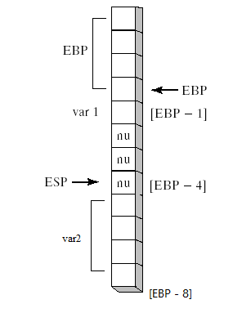
Local Byte Variable
    Example1 PROC
    LOCAL var1:BYTE,var2:DWORD
    mov al,var1 ; [EBP - 1]
    mov eax,var2 ; [EBP - 8]
    ret
    Example1 ENDP
Irvine, Kip R. Assembly Language for Intel-Based Computers 5/e, 2007.

Slide 25
What's Next
Stack Frames
Recursion
INVOKE, ADDR, PROC, and PROTO
Irvine, Kip R. Assembly Language for Intel-Based Computers 5/e, 2007.

Slide 26
Recursion
What is recursion?
Recursively Calculating a Sum
Calculating a Factorial
Irvine, Kip R. Assembly Language for Intel-Based Computers 5/e, 2007.

Slide 27
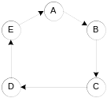
What is Recursion?
The process created when . . .
  A procedure calls itself
  Procedure A calls procedure B, which in turn calls procedure A
Using a graph in which each node is a procedure and each edge is a procedure call, recursion forms a cycle:
Irvine, Kip R. Assembly Language for Intel-Based Computers 5/e, 2007.

Slide 28
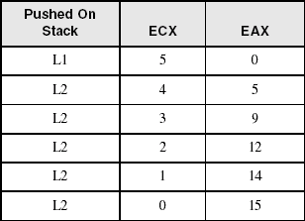
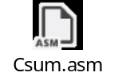
Recursively Calculating a Sum
The CalcSum procedure recursively calculates the sum of an array of integers. Receives: ECX = count. Returns: EAX = sum
CalcSum PROC
cmp ecx,0 ; check counter value
  jz L2 ; quit if zero
  add eax,ecx ; otherwise, add to sum
  dec ecx ; decrement counter
  call CalcSum ; recursive call
L2: ret
CalcSum ENDP
View the complete program
Stack frame:
Irvine, Kip R. Assembly Language for Intel-Based Computers 5/e, 2007.

Slide 29
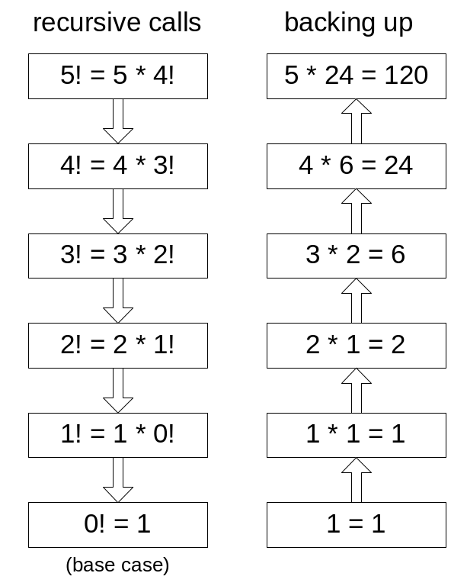
Calculating a Factorial (1 of 3)
This function calculates the factorial of integer n. A new value of n is saved in each stack frame:
int function factorial(int n)
{
if(n == 0)
return 1;
else
return n * factorial(n-1);
}
As each call instance returns, the product it returns is multiplied by the previous value of n.
Irvine, Kip R. Assembly Language for Intel-Based Computers 5/e, 2007.

Slide 30
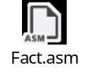
Calculating a Factorial (2 of 3)
Factorial PROC
push ebp
mov ebp,esp
mov eax,[ebp+8] ; get n
cmp eax,0 ; n < 0?
ja L1 ; yes: continue
mov eax,1 ; no: return 1
jmp L2
L1: dec eax
push eax ; Factorial(n-1)
call Factorial
; Instructions from this point on execute when each
; recursive call returns.
ReturnFact:
mov ebx,[ebp+8] ; get n
mul ebx ; eax = eax * ebx
L2: pop ebp ; return EAX
ret 4 ; clean up stack
Factorial ENDP
See the program listing
Irvine, Kip R. Assembly Language for Intel-Based Computers 5/e, 2007.

Slide 31
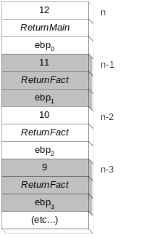
Calculating a Factorial (3 of 3)
Suppose we want to calculate 12!
This diagram shows the first few stack frames created by recursive calls to Factorial
Each recursive call uses 12 bytes of stack space.
Irvine, Kip R. Assembly Language for Intel-Based Computers 5/e, 2007.

Slide 32
What's Next
Stack Frames
Recursion
INVOKE, ADDR, PROC, and PROTO
Irvine, Kip R. Assembly Language for Intel-Based Computers 5/e, 2007.

Slide 33
INVOKE, ADDR, PROC, and PROTO
INVOKE Directive
ADDR Operator
PROC Directive
PROTO Directive
Parameter Classifications
Example: Exchaning Two Integers
Debugging Tips
Irvine, Kip R. Assembly Language for Intel-Based Computers 5/e, 2007.

Slide 34
PROC Directive (1 of 3)
The PROC directive declares a procedure with an optional list of named parameters.
Syntax:
  label PROC [attributes] [USES reglist], paramList
paramList is a list of parameters separated by commas. Each parameter has the following syntax:
  paramName : type
type must either be one of the standard ASM types (BYTE, SBYTE, WORD, etc.), or it can be a pointer to one of these types (PTR BYTE, PTR SBYTE, PTR WORD, etc.).
Irvine, Kip R. Assembly Language for Intel-Based Computers 5/e, 2007.

Slide 35
PROC Directive (2 of 3)
Alternate format permits parameter list to be on one or more separate lines:
  label PROC,
  paramList
The parameters can be on the same line . . .
  param-1:type-1, param-2:type-2, . . ., param-n:type-n
Or they can be on separate lines:
  param-1:type-1,
  param-2:type-2,
  . . .,
  param-n:type-n
comma required
Irvine, Kip R. Assembly Language for Intel-Based Computers 5/e, 2007.

Slide 36
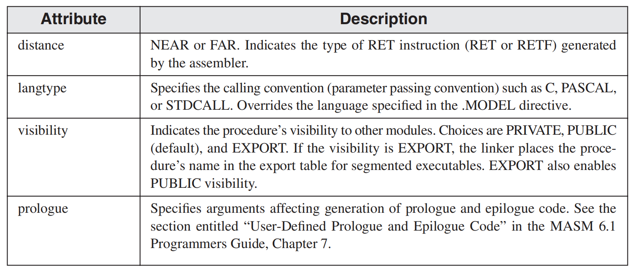
PROC Directive (3 of 3)
Syntax:
  label PROC [attributes] [USES reglist], paramList
Attributes refers to any of the following:
  [distance] [langtype] [visibility] [prologue]
Irvine, Kip R. Assembly Language for Intel-Based Computers 5/e, 2007.

Slide 37
AddTwo Procedure (1 of 2)
The AddTwo procedure receives two integers and returns their sum in EAX.
AddTwo PROC,
val1:DWORD, val2:DWORD
mov eax,val1
add eax,val2
ret
AddTwo ENDP
Irvine, Kip R. Assembly Language for Intel-Based Computers 5/e, 2007.

Slide 38
AddTwo Procedure (2 of 2)
The arguments are pushed in reverse order for STDCALL and C
MASM generates the following code when we assemble AddTwo (from the previous panel):
AddTwo PROC,
val1:DWORD, val2:DWORD
push ebp
mov ebp, esp
mov eax,val1 ; val1=dword ptr [ebp+8]
add eax,val2 ; val2=dword ptr [ebp+0Ch]
leave
ret 8
AddTwo ENDP
The LEAVE instruction is shorthand for:
mov esp,ebp
pop ebp
Irvine, Kip R. Assembly Language for Intel-Based Computers 5/e, 2007.

Slide 39
PROC Examples (1 of 2)
FillArray receives a pointer to an array of bytes, a single byte fill value that will be copied to each element of the array, and the size of the array.
FillArray PROC,
pArray:PTR BYTE, fillVal:BYTE
arraySize:DWORD
mov ecx,arraySize
mov esi,pArray
mov al,fillVal
L1: mov [esi],al
inc esi
loop L1
ret
FillArray ENDP
Irvine, Kip R. Assembly Language for Intel-Based Computers 5/e, 2007.

Slide 40
PROC Examples (2 of 2)
Swap PROC,
  pValX:PTR DWORD,
  pValY:PTR DWORD
  . . .
Swap ENDP
ReadFile PROC,
pBuffer:PTR BYTE
LOCAL fileHandle:DWORD
. . .
ReadFile ENDP
Irvine, Kip R. Assembly Language for Intel-Based Computers 5/e, 2007.

Slide 41
INVOKE Directive
The INVOKE directive pushes arguments on the stack (in reverse order for STDCALL and C) and calls a procedure.
A powerful replacement for Intel’s CALL instruction that lets you pass multiple arguments
Syntax:
    INVOKE procedureName [, argumentList]
ArgumentList is an optional comma-delimited list of procedure arguments
Arguments can be:
  immediate values and integer expressions
  variable names
  address and ADDR expressions
  register names
Irvine, Kip R. Assembly Language for Intel-Based Computers 5/e, 2007.

Slide 42
ADDR Operator
Returns a near or far pointer to a variable, depending on which memory model your program uses:
  Flat model: returns 32-bit offset
Can only be used in INVOKE statement
The argument of ADDR must be an assembly time constant
Simple example:
.data
myWord WORD ?
.code
INVOKE mySub,ADDR[esi] ;error
INVOKE mySub,ADDR myWord
Irvine, Kip R. Assembly Language for Intel-Based Computers 5/e, 2007.

Slide 43
INVOKE Examples (1 of 2)
AddTwo PROC,
val1:DWORD, val2:DWORD
. . .
ret
AddTwo ENDP
.data
pa DWORD 10
pb DWORD 20
.code
; direct operands:
INVOKE AddTwo,pa,pb
; register name, integer expression:
INVOKE AddTwo,eax,(10 * 20)
; address expression (indirect operand):
INVOKE AddTwo,[esi],[edi+8]
Irvine, Kip R. Assembly Language for Intel-Based Computers 5/e, 2007.

Slide 44
INVOKE Examples (2 of 2)
Swap PROC,
  pValX:PTR DWORD,
  pValY:PTR DWORD
  . . .
Swap ENDP
.data
pa DWORD 10
pb DWORD 20
.code
; address of variable:
INVOKE Swap,ADDR pa,ADDR pb
; address of variable:
INVOKE Swap,OFFSET pa,OFFSET pb
Irvine, Kip R. Assembly Language for Intel-Based Computers 5/e, 2007.

Slide 45
PROTO Directive
Creates a procedure prototype
Syntax:
  label PROTO [attributes], paramList
Every procedure called by the INVOKE directive must have a prototype
A complete procedure definition can also serve as its own prototype
The attributes of PROTO must be consistent with the procedure’s PROC declaration
PROTO do not have USES
Irvine, Kip R. Assembly Language for Intel-Based Computers 5/e, 2007.

Slide 46
PROTO Directive
Standard configuration: PROTO appears at top of the program listing, INVOKE appears in the code segment, and the procedure implementation occurs later in the program:
MySub PROTO ; procedure prototype
.code
INVOKE MySub ; procedure call
MySub PROC ; procedure implementation
.
.
MySub ENDP
Irvine, Kip R. Assembly Language for Intel-Based Computers 5/e, 2007.

Slide 47
PROTO Example
Create a prototype for the ArraySum procedure
ArraySum PROC C USES esi ecx,
ptrArray:PTR DWORD, ; points to the array
szArray:DWORD ; array size
ArraySum PROTO C,
ptrArray:PTR DWORD, ; points to the array
szArray:DWORD ; array size
Irvine, Kip R. Assembly Language for Intel-Based Computers 5/e, 2007.

Slide 48
Your turn . . .
Create a procedure named Difference that subtracts the first argument from the second one, return the result in EAX. Create the PROTO of the procedure and use INVOKE directive to call the procedure.
Difference PROTO,
pa:DWORD,
pb:DWORD
INVOKE Difference,1,2
Difference PROC,
pa:DWORD,
pb:DWORD
mov eax,pa
sub eax,pb
ret
Difference ENDP
Irvine, Kip R. Assembly Language for Intel-Based Computers 5/e, 2007.

Slide 49
Summary
Stack parameters
  more convenient than register parameters
  passed by value or reference
  ENTER and LEAVE instructions
Local variables
  created on the stack below stack pointer
  LOCAL directive
Recursive procedure calls itself
Calling conventions (C, stdcall)
MASM procedure-related directives
  INVOKE, PROC, PROTO
Irvine, Kip R. Assembly Language for Intel-Based Computers 5/e, 2007.

Slide 50

The End
Irvine, Kip R. Assembly Language for Intel-Based Computers 5/e, 2007.

